Slide 1

Your Body Is
Not the Problem
Grades 7–9
Together For Health

Slide 2
89%
of teen girls have gone on a diet, skipped meals, or changed eating based on appearance goals (NEDA)
Negative body image is one of the primary risk factors for eating disorders, depression, and anxiety in adolescents.
Together For Health

Slide 3

📱
Social Media & Body Image
Instagram and TikTok algorithms actively prioritize content with "ideal" bodies
Average teen sees 500+ manipulated body images per day
Social comparison theory: we evaluate ourselves relative to others — social media optimizes for this
Fitspiration accounts linked to 29% increase in body dissatisfaction
Body checking behaviours: comparing, mirror checking, weighing — become compulsive
Together For Health

Slide 4
⚠️
When Body Image Becomes Dangerous
Restricting food: skipping meals, cutting out entire food groups
Binge-purge cycles: eating large amounts then using laxatives or vomiting
Excessive exercise: exercising compulsively to change appearance even when sick or injured
Body dysmorphia: obsessive focus on perceived flaws others cannot see
Steroid or supplement use to alter body composition
Together For Health

Slide 5
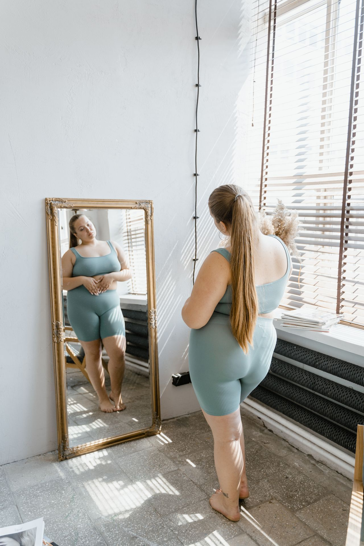
💪
Shifting to a Body-Neutral Framework
Focus on what your body does (runs, laughs, creates) not how it looks
1
Curate your social media: unfollow accounts that make you feel worse
2
Challenge the "thin ideal": diverse body representation in media exposure
3
Practice gratitude for functional body parts
4
Avoid diet culture language: foods are not "good" or "bad" — they are food
5
Together For Health

Slide 6
📊
The Diet Industry
The diet industry generates $72 billion USD per year. It profits from your insecurity.
95% of diets fail within 5 years. The industry is designed to keep you cycling back. Awareness is resistance.
Together For Health

Slide 7
KEY TAKEAWAYS
Body image is shaped by culture — it can be changed by culture too
✓
Health is not a size, shape, or number on a scale
✓
You deserve to take up space exactly as you are
✓
Resources
Body Brave: bodybrave.ca
National Eating Disorder Information Centre: nedic.ca
Kids Help Phone: 1-800-668-6868
Together For Health

